Slide 1

PRESENTATION
ON
TYPES OF COMPUTER

Slide 2

Computer can be classified it to following
defined below
basis
On the basis of functionality.
On the basis of Size, Speed and Cost.

Slide 3
On The Basis of Functionality
According to functionality
computer
can
be
divided
1. Analog
^{2. Digital}
3. Hybrid
in
to
three
types:

Slide 4
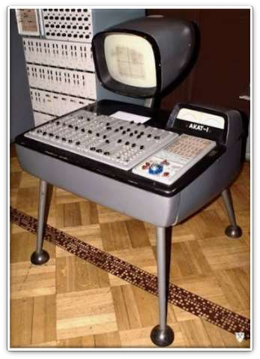
Analog Computer
“An analog (spelled analogue in British
English) computer is a form of computer
that uses the continuously-
changeable aspects of physical fact such as
electrical, mechanical, or hydraulic
quantities to model the problem being
solved.”
Analog means continuity of associated quantity just like an analog clock measures time by means of the distance travelled by the hand of the clock around a dial.
Example: Thermometer, Analog clock,
Speedometer, Tire pressure Gauge.

Slide 5
Characteristics of Analog
Computers
❖ The Speed of analog computer is fast
❖ These computers are not reliable
❖ These computers became the base for digital computers
❖ These computers are difficult to operate and use
❖ These computers are easy to develop
❖ These computers have small memory

Slide 6
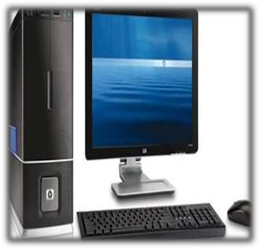
Digital Computer
“A computer that performs calculations and logical
operations with quantities represented as digits,
usually in the binary number system of “0” and “1”.
“Computer capable of solving problems by
processing information expressed in discrete form. By
manipulating combinations of binary digits (“0”, “1”), it can perform mathematical calculations, organize and analyze data, control industrial and other processes, and simulate dynamic systems such as global weather patterns. ”
EXAMPLES:
IBM PC
Apple Macintosh
Calculators
Digital watches etc

Slide 7
Characteristics of Digital
Computer
❖ These computers are easy to use.
❖ Human being like to use digital computers.
❖ These computers are reliable.
❖ Digital computers have big memory.
❖ Working speed of digital computers is slower as compared to analog
computers.
❖ These computers are further divided into different categories such as
personal computers, Mainframe computers and super computers.

Slide 8
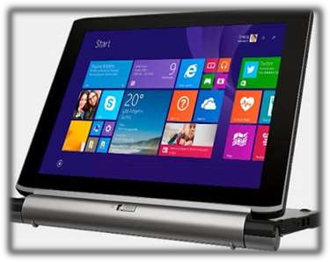
Hybrid
Computer
A hybrid computer is a combination of
computers that are capable of inputting
and outputting in
both digital and analog signals.
Traditionally, the analog components of
the computer handle complex
mathematical computations. The digital
components take care of logical and
numerical operations in addition to
serving as the controller for the system.
Hybrid computers for example are used
for scientific calculations, in defence and
radar systems.
Example: Notebook, Laptop etc.

Slide 9
Characteristics of Hybrid Computers
❖ These computers are reliable and provide accurate result.
❖ These computers are fast and speedy.
❖ These computers are easy to move
❖ These computers are cheaper

Slide 10
Computer
(on the basis of size, speed and performance)
Micro Computer
Super Computer
Mini Computer
Main-Frame
Computer

